Slide 1
Hive Connect
AMAL MANOJ (717823Z106)
KRISHNAN N (717823Z132)
MINI PROJECT
(23EXC302)
Supervisor:
Dr. K. Anuradha MCA, Ph.D.,
Director,
School of Computer Applications
Date: 28/11/2024

Slide 2
CONTENTS
SL.NO | TITLLE | PAGE.NO
01 | Abstract | 03
02 | Existing System | 04
03 | Proposed System | 06
04 | System Requirements | 08
05 | Module Description | 09
06 | ER Diagram | 11
07 | Use Case Diagram | 12
08 | Data Flow Diagram | 13
09 | Database Design | 15
10 | Conclusion | 17
11 | Future Enhancement | 18
12 | Screenshots | 19
13 | Reference | 25

Slide 3
1. ABSTRACT
Hive Connect is a web-based application designed to streamline the process of finding reliable and skilled local service providers.
The primary goal of Hive Connect enables users to quickly discover service professionals within their locality.
The system is built to record, store, and update service provider information systematically, ensuring that all listings are accurate and up-to-date.
By utilizing a user-friendly search engine, Hive Connect allows users to filter through various service categories, compare options, and make informed decisions based on service provider ratings, availability, and proximity.
The platform also facilitates the continuous management of service provider records, allowing businesses to maintain and update their listings in real time.

Slide 4
2. EXISTING SYSTEM
Traditionally, finding local service providers such as plumbers, electricians, tutors, or cleaners has relied on a mix of informal networks and generalized platforms.
Some communities may also have small-scale websites or social media groups dedicated to local services, where providers can advertise their expertise and users can post requests for recommendations.
These platforms sometimes facilitate direct communication between users and service providers, allowing users to gather quotes, discuss service details, and arrange appointments.

Slide 5
2.1 Challenges of the Existing System
Fragmented Access to Providers
Lack of Centralized Information
Time-Consuming Search and Selection Process
Inconsistent Quality Control
Privacy and Security Risks

Slide 6
3. PROPOSED SYSTEM
The proposed Hive Connect platform seeks to establish a centralized, efficient, and user-friendly system that redefines how local services are discovered, managed, and delivered.
The platform will provide administrators with the tools to manage service categories, maintain provider profiles, and ensure that data remains organized and reliable. For users, it will offer an intuitive interface that simplifies the search and communication process, ensuring that the right service providers can be found with minimal effort.
Hive Connect will emphasize security, privacy, and ease of use, ensuring that both users and service providers can trust the platform to handle their interactions and data securely.

Slide 7
3.1 Advantages of the Proposed System
Local Service Discovery
Community Engagement
Scalability and Future Expansion
Provider Management
User-Centric Platform

Slide 8
4. SYSTEM REQUIREMENTS
HARDWARE REQUIREMENTS
PROCESSOR : i3 Processor
HARD DISK : 256 GB
RAM : 4 GB or above
SOFTWARE REQUIREMENTS
OPERATING SYSTEM : WINDOWS 10
SERVER SIDE LANGUAGE : PHP
DATABASE : MySQL
WEB SERVER : XAMPP
IDE : VISUAL STUDIO CODE

Slide 9
5. MODULE DESCRIPTION
ADMIN MODULE
ADMIN
DASHBOARD
SERVICE MANAGEMENT
PROVIDER MANAGEMENT
USER MANAGEMENT
REPORT AND ANALYTICS
SYSTEM SETTINGS

Slide 10
5. MODULE DESCRIPTION
USER MODULE:
USER
USER DASHBOARD
SERVICE SEARCH
PROVIDE PROFILES
USER PROFILE MANAGEMENT
DIRECT COMMUNICATION

Slide 11
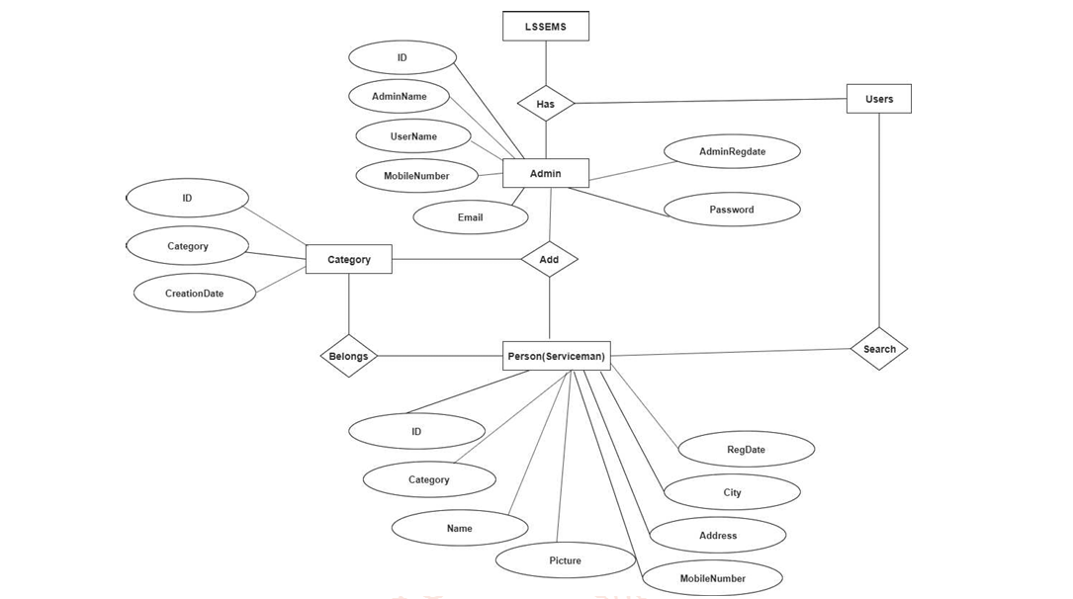
6. ER DIAGRAM

Slide 12
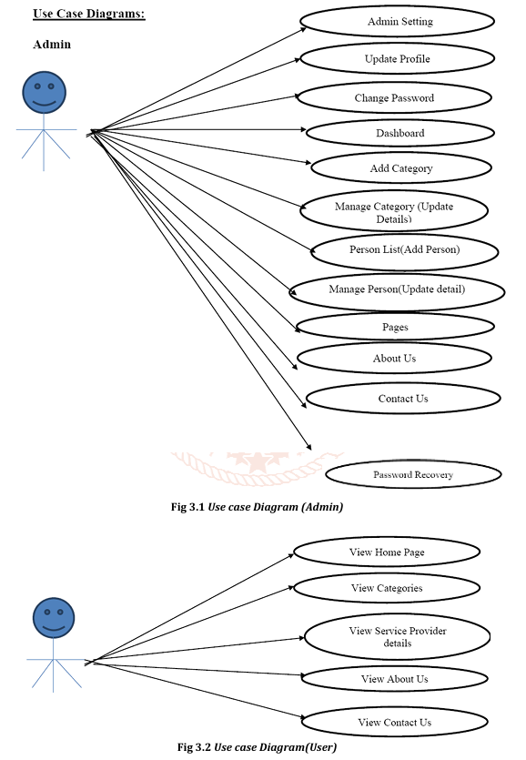
7. USE CASE DIAGRAM

Slide 13
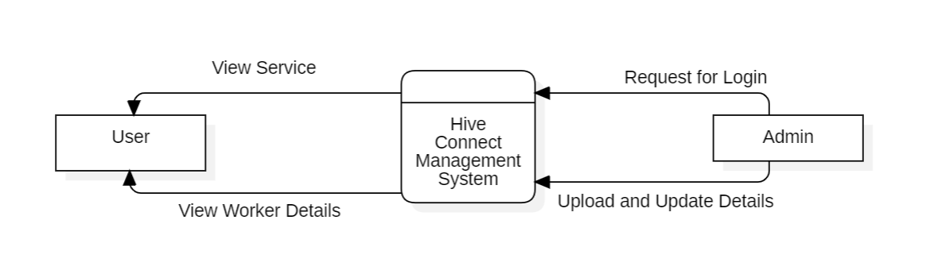
8. DATA FLOW DIAGRAM
DFD LEVEL 0

Slide 14
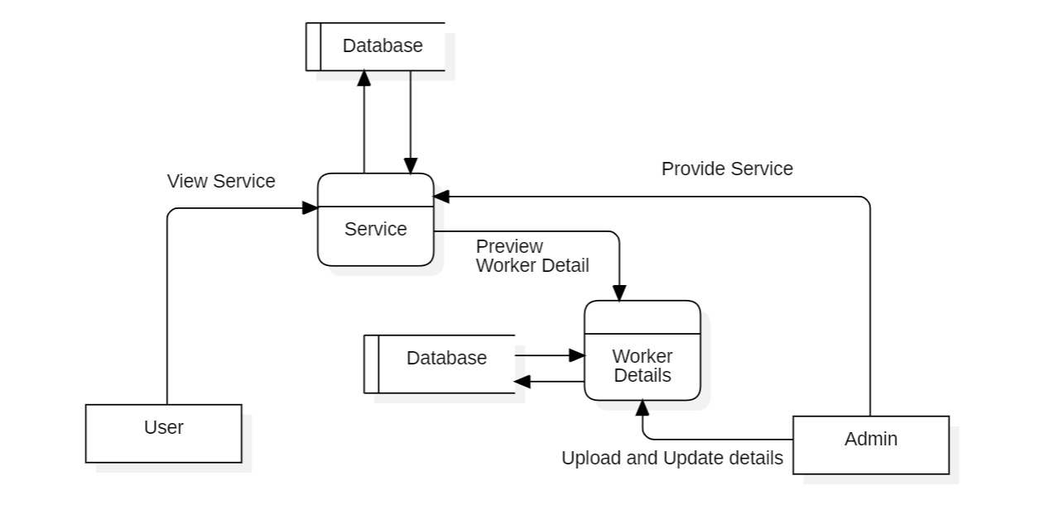
8. DATA FLOW DIAGRAM
DFD LEVEL 1

Slide 15
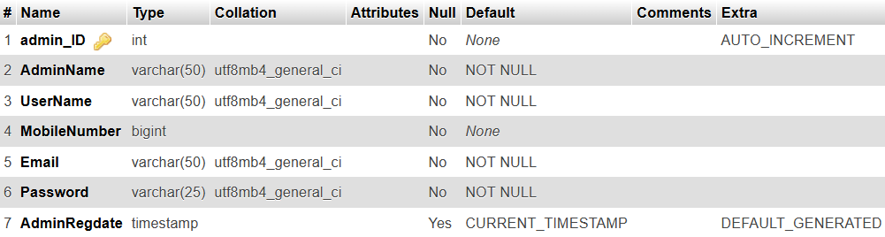
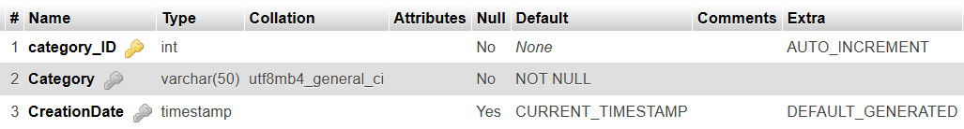
9. DATABASE DESIGN
Table structure:
Table name: Admin
Primary key: ADMIN_ID
Description: To store the admin details
Table structure:
Table name: Category Table
Primary key: CATEGORY_ID
Description: To store the category details

Slide 16
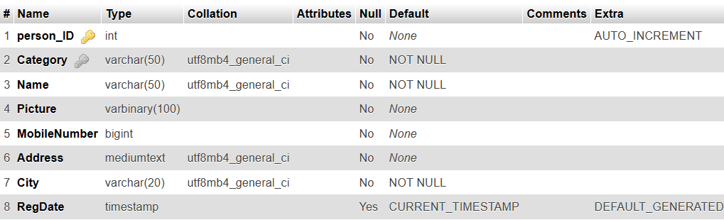
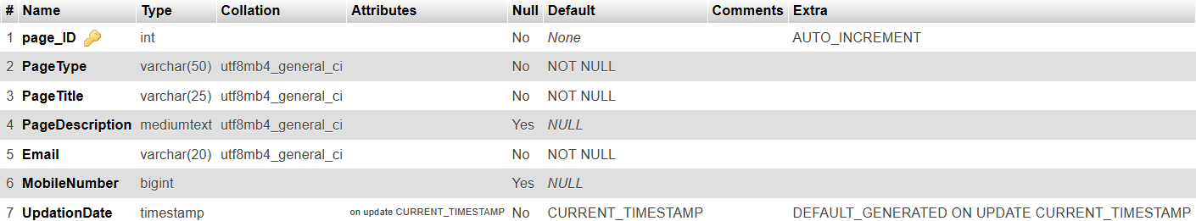
9. DATABASE DESIGN
Table name: Person Table
Primary key: PERSON_ID
Description: To store the person details
Table name: Page Table
Primary key: PAGE_ID
Description: To store the page details

Slide 17
10. CONCLUSION
In conclusion, the " Hive Connect " project, tailored for colleges, stands as a valuable asset for educational institutions.
In summary, the " Hive Connect " project is a significant contribution to the world of higher education, providing colleges with the tools to gather meaningful insights from survey data and drive informed decision-making.
Hive Connect provides an innovative solution to the traditional methods of discovering and connecting with local service providers. By offering a centralized, user-friendly platform, Hive Connect enhances the accessibility and efficiency of finding and managing local services.
*
The system not only streamlines the communication between users and service providers but also ensures that data is well-organized and up-to-date, fostering trust and reliability within the community.
*
This centralized approach helps to create a more connected, engaged local community, offering a valuable resource for users and service providers alike.
*

Slide 18
11. FUTURE ENHANCEMENT
While Hive Connect offers a comprehensive platform for local service management, there are several areas for future enhancement that could further improve its functionality and reach:
These future enhancements will not only refine the user experience but also position Hive Connect as a comprehensive, all-encompassing platform for local services and community building.
Advanced Search and Recommendation System
Rating and Review System
Mobile App Development
Expanded Payment Integration

Slide 19

12. SCREENSHOTS
Home Page

Slide 20
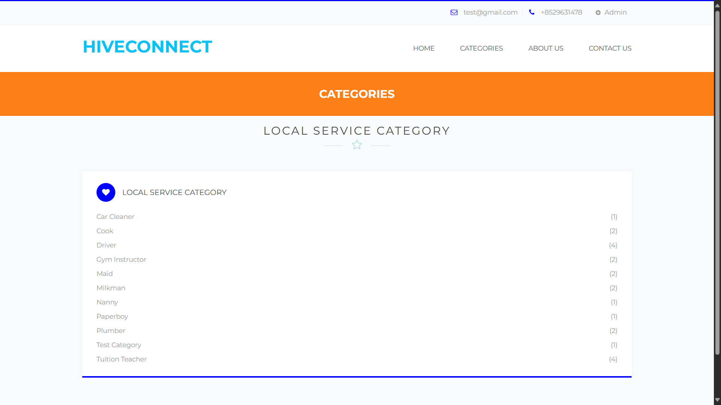
Categories Page

Slide 21
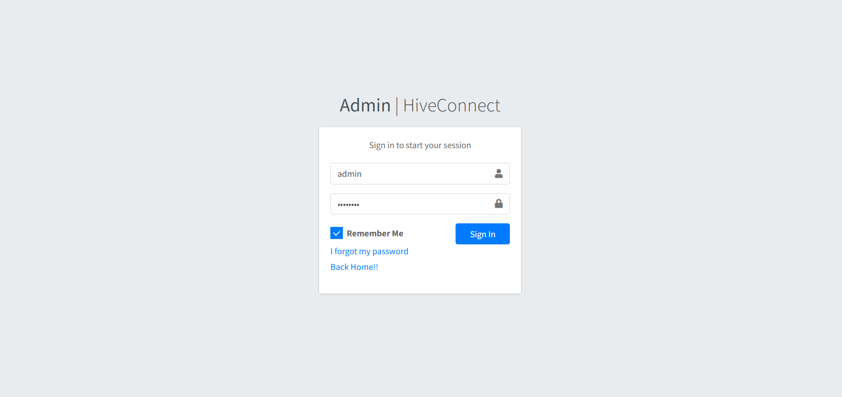
Admin Login

Slide 22
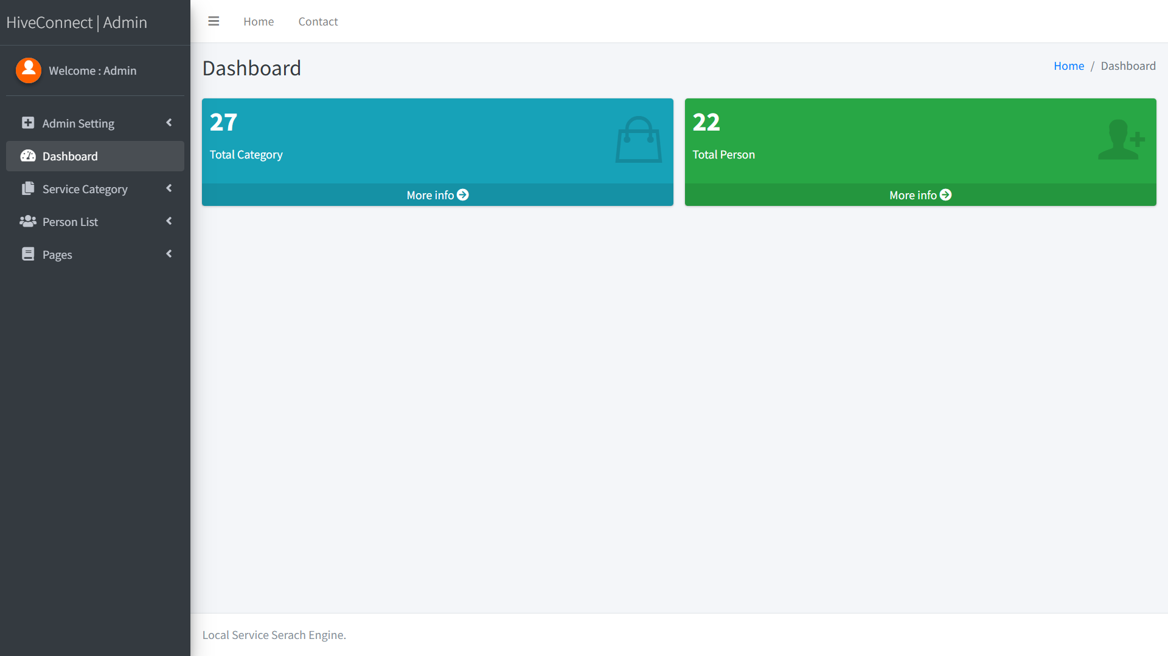
Admin Dashboard

Slide 23
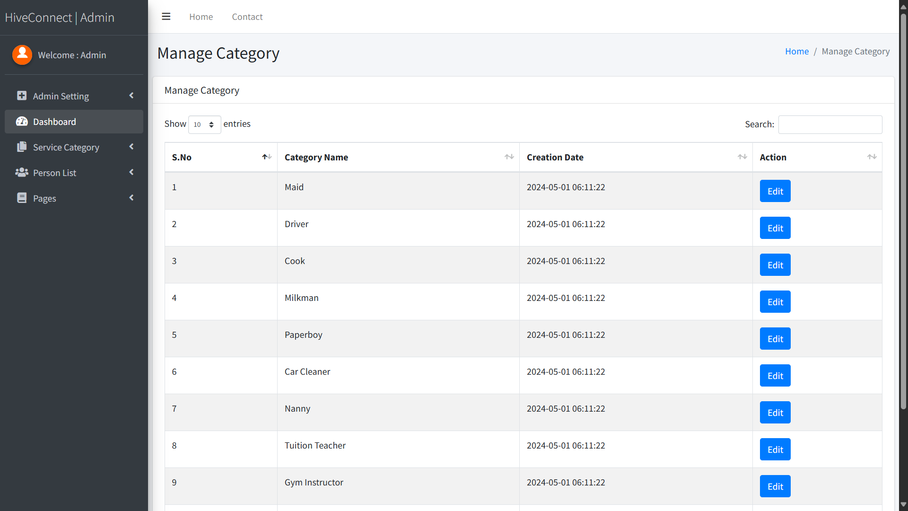
Admin Manage Category

Slide 24
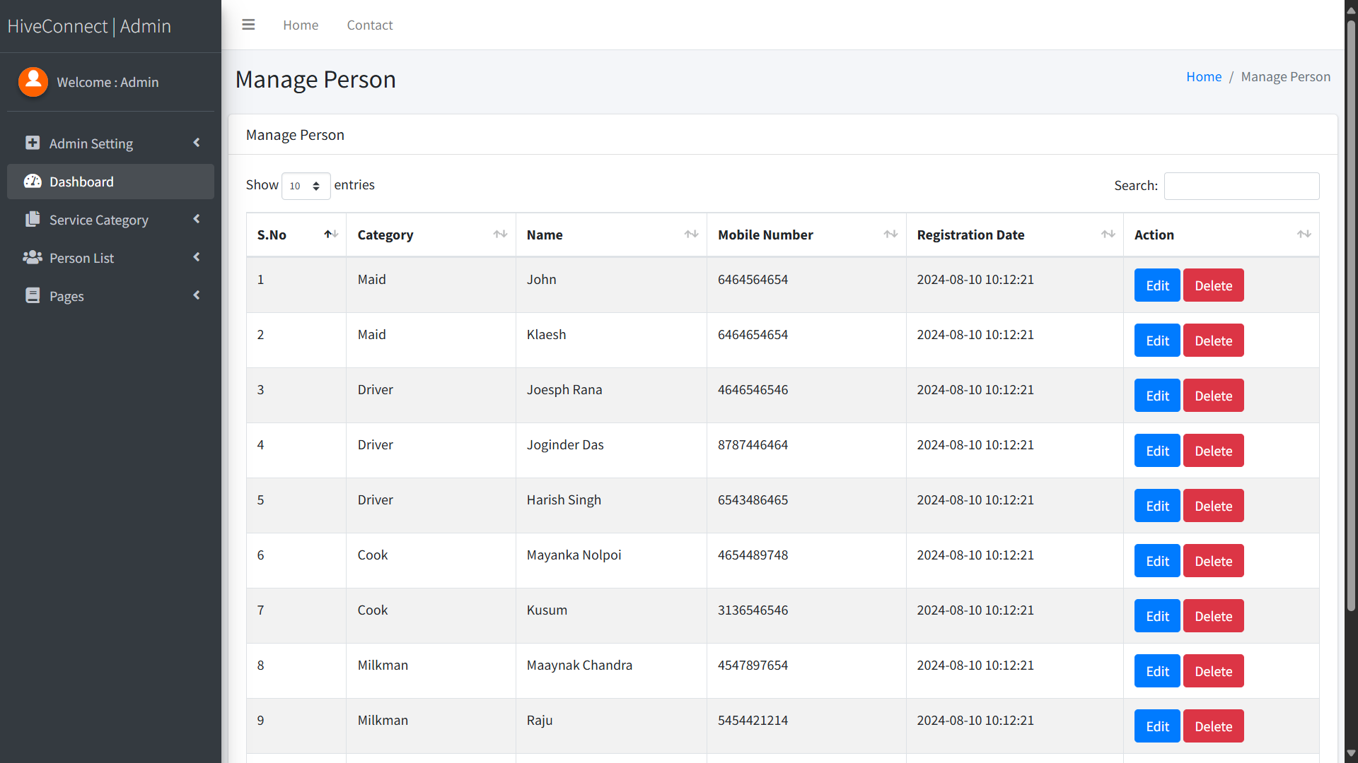
Admin Manage Person

Slide 25
13. REFERENCE
TEXT BOOKS
Luke welling, Laura Thomson, “PHP and MYSQL Web development”, 3rd edition.
Kevin Tat roe, “Programming PHP”, 3rd edition, Pearson Education.
Andy Harris, “PHP/MYSQL Programming for the absolute beginner”.

Slide 26
THANK YOU

